Slide 1
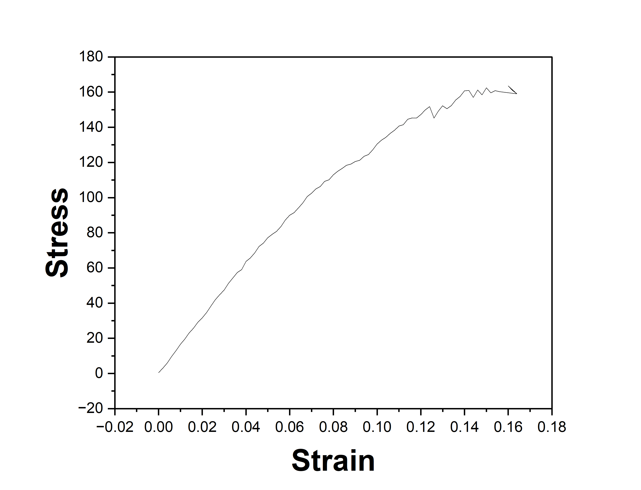
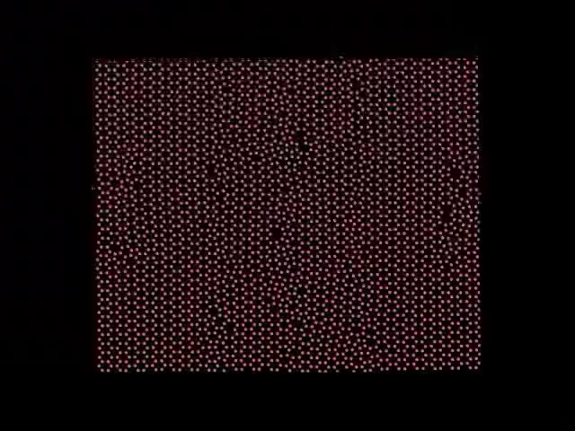
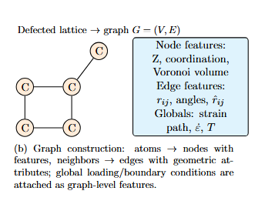
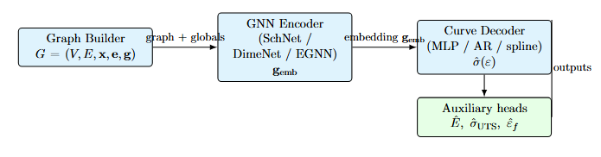
Graph Neural Networks for Predicting Mechanical Response in Defective Graphene
We have a dataset containing the void fraction in graphene along with its corresponding mechanical response. Our goal is to develop a robust GNN-based framework to accurately predict these properties.
Data Received from MD
UTS: 160 Gpa
Fracture Strain: 0.16
Play the video!
GNN Framework!!
Deliverable: notebook with code and robust framework

